Slide 1
EMPLOYEE DATA ANALYSIS USING EXCEL
STUDENT NAME: ELAKKIYA M
REGISTER NO: 2213371036114
DEPARTMENT: COMMERCE
COLLEGE: QUAID-E-MILLATH GOVERNMENT COLLEGE FOR WOMEN
1
Notes:
1

Slide 2
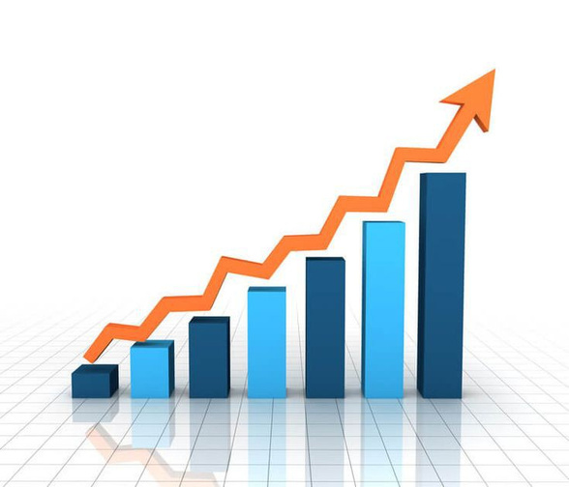

PROJECT TITLE
Employee Performance Analysis using Excel
2

Slide 3

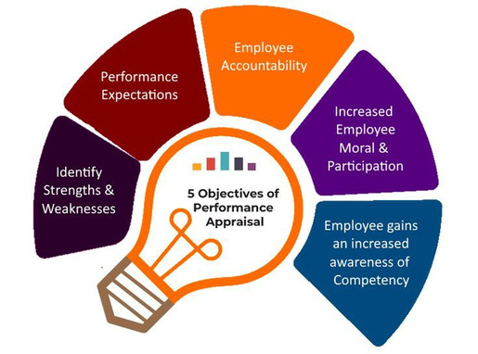
AGENDA
Problem Statement
Project Overview
End Users
Our Solution and Proposition
Dataset Description
Modelling Approach
Results and Discussion
Conclusion
3

Slide 4
PROBLEM STATEMENT
EMPLOYEE PERFORMANCE ANALYSIS
By Analyzing Employee Performance Data set we can recognize employees who
consistently exceeds performance expectations.
Can create a list of top performer who maybe considered for promotions, bonuses, or
leadership roles.
Determine areas where employees may need additional training or professional
development.
Monitor employee attendance, absenteeism, and punctuality.
Analyze how efficiently employees are completing their assigned tasks or projects.
4

Slide 5
PROJECT OVERVIEW
EMPLOYEE PERFORMANCE ANALYSIS
The goal for preparing this is to analyze the employee performance by considering various factors like Gender, Performance Score, Employee Rating, Performance level, Achievement.
The analysis will help in identifying top performers, areas for improvements, and trends in performance overtime.
The data-driven approach will assist in making informed decisions for employee
development, promotions, and resource allocation.
After this process it is helpful to create trend and pattern of different categories of employee like their performance level.
5

Slide 6
WHO ARE THE END USERS?
HUMAN RESOURCE DEPARTMENT:
To make informed decisions regarding promotions, training needs, performance, improvements plans, and employee retention strategies.
EMPLOYEES THEMSELVES:
Employees can set personal development goal and have transparency in performance evaluations.
FINANCE DEPARTMENT:
The finance team can budget more accurately for performance-related expenditures.
BOARD OF DIRECTORS:
The board can use this data to guide long-term organizational strategies.
6

Slide 7



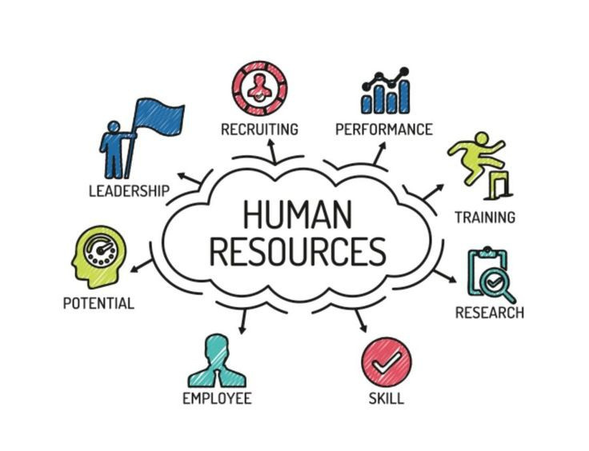



Slide 8
OUR SOLUTION AND ITS VALUE PROPOSITION
Formula- For identifying the performance of employee
Pivot- To convert the data into short summary
Graph- Data Visualization
7

Slide 9
DATASET DESCRIPTION
EMPLOYEE INFORMATION
Employee ID- numerical (e.g., EMP001, EMP002)
Name- text (e.g., Sandhya, Swetha)
Gender-text (Male, Female)
Business Unit- text (e.g., CCDR, EW, TNS)
Department- text (e.g., Marketing, Engineering, Human Resource)
Employee Type- text (e.g., Permanent, Fixed Term, Temporary)
Work Location- text (e.g., New Zealand, India, USA)
Performance Score- text (e.g., Fully Meets, Exceeds)
Current Employee Rating- numerical (e.g., 4,3)1
Performance Level- text (e.g., High, Medium, Low)

Slide 10
THE "WOW" IN OUR SOLUTION
Performance Level = IFS(Z8>=5,”VERY HIGH”,Z8>=4,”HIGH”,Z8>=3,”MED”,TRUE,”LOW”)
9

Slide 11
MODELLING
DATA COLLECTION:
Collect data from Kaggle and shortlist according to your way
like selecting important information about employees performance and analysis.
FEATURE COLLECTION:
In this method we are shortlisting the data set according to our way from 26 feature to 12 features data set which is important according to my opinion.
PERFORMANCE LEVEL:
In this step we create a certain formula to find out the employees performance level. It shows which employee meet the expectation or exceed expectation. Employee who occasionally fall short of expectation and need improvement in specific areas.
SUMMARY:
In this we can dynamically analyze and summarize data, showing performance levels across different departments or employee groups.
10

Slide 12
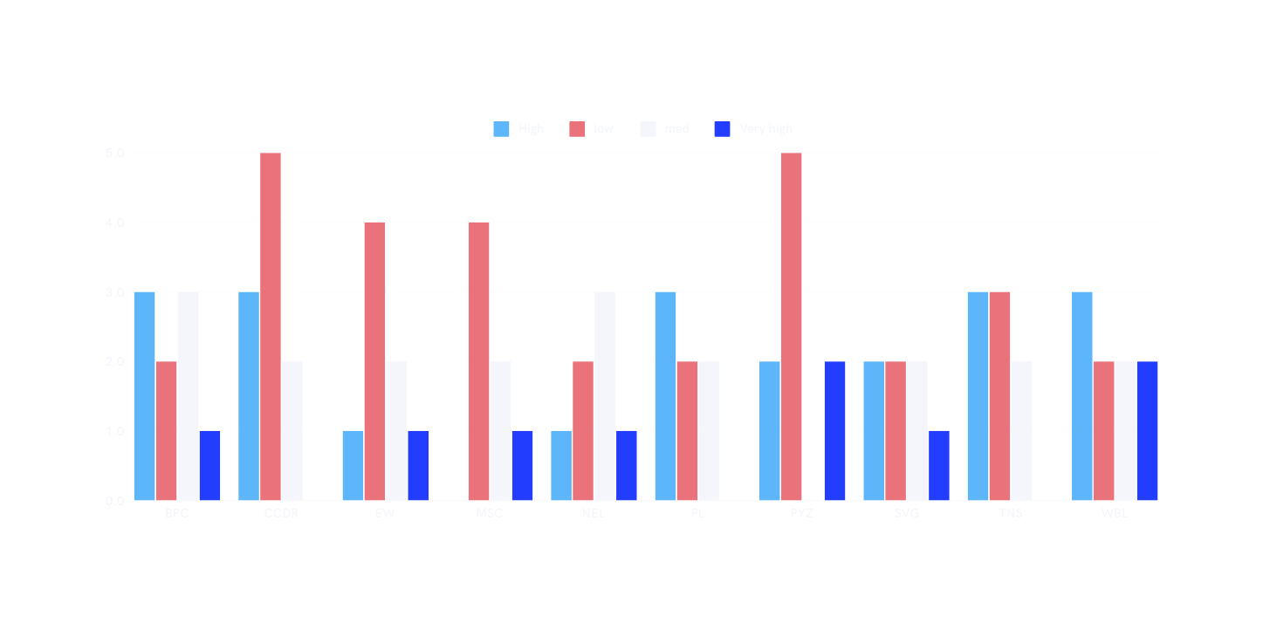
RESULTS
11

Slide 13
CONCLUSION
Variation in Performance Levels:
There is a significant variation in performance levels across different employees or departments. Some entities(e.g., EW, NEL) have a higher proportions of “Low” and “Medium” performance, while others(e.g., BPC, PYZ) show a mix of “High” and “Very High” performance.
Consistency Across Categories:
For some entities like CCDR and TNS performance is more evenly distributed across categories, indicating a balanced performance level without extreme highs or lows.
Areas of Concern:
Entities with a high proportion of “Low” performance (e.g., EW) may require targeted intervention such as additional training, better resources allocation, or process improvements to enhance their overall performance.

